Slide 1
Water cycle story board
By: Reilly Skerbetz
Period 1
10-15-10

Slide 2
Characters:
Lady dropper
Mr. Sun
Sir Dripper

Slide 3
This is lady dropper. “hello friends.”
Hello friends.

Slide 4
“I live in the ocean near North Myrtle beach, South Carolina.”

Slide 5
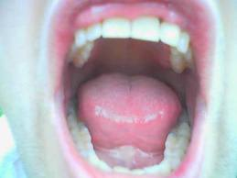
“Oh no!” said Lady dropper. “it’s the EVIL Mr. Sun, who makes it so hot.”
1
evaporation

Slide 6
“I wish my Spidey senses would kick in so I can go up to the clouds where its it is cool!” Lady dropper exclaimed.

Slide 7
“yes!” Lady dropper’s Spidey senses kicked in and she shot up to the clouds like a rocket.
2
Water vapor
Yes!

Slide 8
“wow, these clouds are really fluffy!” said Lady dropper. “I know, it is so easy to sleep up here!” said a voice near her. She didn’t know where the voice came from or who said it.
3
condensation
Wow, these clouds are so fluffy!
I know, its so easy to sleep up here!

Slide 9
“Who said that?” asked Lady dropper. The voice was there again. “It was me.” said the voice.
3
condensation
It was me.
Who said that?

Slide 10
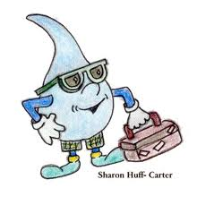
“who is me?” “allow me to introduce myself, my name is Sir Dripper.” said the voice.
3
condensation
Allow me to introduce myself, my name is Sir Dripper
Who is me?

Slide 11
“hello Sir Dripper. My name is Lady Dropper.” “Its very nice to meet you Lady dropper.” said Sir dripper.
3
condensation
Its very nice to meet you Lady dropper.
Hello Sir Dripper. My name Is Lady Dropper.

Slide 12
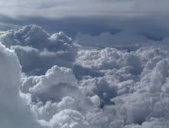
“Have you ever been up here before?” asked Sir dripper. “Nope, this is my first time in the clouds.” said lady dropper.
3
condensation
Nope, this is my first time in the clouds.
Have you been up here before?

Slide 13
Boom!!! (scream) “What was that!” said lady dropper.
3
Boom!
condensation
What was that?

Slide 14
“its just thunder, but it scares me every time!” said sir dripper.
3
condensation
Its just thunder, but it scares me every time!

Slide 15
“ here comes the lightening, get ready to jump!” said sir dripper.
3
condensation
Here comes the lightening, get ready to jump!

Slide 16
“ ahhhh!” exclaimed lady dropper.
4
precipitation

Slide 17
Sploosh! Lady dropper fell into a stream.
5
Run off

Slide 18
“wee!” said lady dropper as she rode through the stream.
5
Run off

Slide 19
“ahh! Back in my home. In north myrtle beach, south Carolina.”
5
Run off

